Slide 1
Hashing: Implementation Issues
EECS 233

Slide 2
Issues and Questions
As the hash table is used, more positions will be marked removed
  How does this affect running time?
    Insertion?
    Search? (Successful/unsuccessful)?
    Deletion?
If the hash table gets almost full, how does this affect running time?
  Insertion?
  Search?
  Deletion?

Slide 3
Hash Table Performance May Degrade
When many entries are “removed”, search must continue
  If the searched key is in the table, it is likely to be found after a few iterations
  However, if the key is not in the table at all, search continues until reaching an “empty” entry, potentially approaching N iterations (N is the size of the table)
When most entries are occupied, insertion method may not be able to find an open position quickly
  the load factor λ of a hash table is the ratio of the number of keys to the table size.
  The expected number of iterations obviously grows with λ

Slide 4
Rehashing
What to do in the first case?
  Here the load factor is not high at all, but that many entries are not utilized (marked as “removed”).
    the load factor can be easily tracked.
  “Rehash” the entries: Create another hash table, and move every entry to the new table
What to do in the second case?
  Here the problem is high load factor
  Expand the hash table: create a new hash table of roughly doubled size, and move the entries to the new table
What is the running time of rehashing? Does it affect the overall running of hash table operations?
  May not happen very often, e.g., once every O(N) insertions
  But when it happens, may take some running time

Slide 5
Rehash() Method (Expanding)
  public class HashTable {
    private class Entry {
      private String key;
      private String etymology;
      private boolean removed;
    }
    private Entry[] table;
    private int tableSize;
    ...
  }
Let us still consider the example hash table:
    public void rehash( ) {
      int oldSize = tableSize;
      Entry[ ] oldTable = table;
      tableSize = nextPrime(2 * oldSize);
      table = new Entry[tableSize];
      for(i = 0; i < oldSize; i++)
        if ( ? )
        ?
    }
We define rehash() as public so the user can decide when to rehash

Slide 6
Efficiency of Hash Tables
In the best case, search and insertion are O(1).
In the worst case, search and insertion are linear.
  open addressing: O(m), where m = the size of the hash table
  separate chaining: O(n), where n = the number of keys
With a good choice of hash function and table size, the time complexity is generally better than O(log n) and approaches O(1).
As the load factor increases, performance tends to decrease.
  Open addressing: try to keep the load factor < ½
  Separate chaining: try to keep the load factor < 1
Time-space tradeoff: bigger tables tend to have better performance, but they use up more memory.

Slide 7
Limitations of Hash Tables
It can be hard to come up with a good hash function for a particular data set.
  The choice of hash functions may depend on the characteristics of the data set.
The items are not ordered by key. As a result, we can’t easily
  Print the contents in sorted order
  Solve the selection problem - get the k-th largest item
We can do all of these things with many tree structures.

Slide 8
Implementation of Hash Function

Slide 9
Hash Functions Desiderata Revisited
Example: String as key (e.g., Webster)
  keys = character strings composed of lower-case letters
  hash function:
    h(key) = (the byte sum of all characters) mode table-size
    example: h(“cat”) = (‘a’ + ‘c’ + ‘t’) mod 100000
    But: assume words are mostly up to 20 character-long
      Max sum is 127*20 = 2540; any larger table is of no use!
    But: permutations are not distinguished
      h(“cat”) = h(“act”)
Requirements for good hash functions:
  Full table size utilization
  Even (“uniform”) key mapping throughout the table
    Utilizing known key distribution in the objects
    Making hash function “random” - the distribution of keys is independent of distribution of indexes to which they map
Using the entire key to compute the hash value
Must be efficient to compute!

Slide 10
Hash Functions for Strings
Bad example: the sum of the character codes
A better example: a weighted sum of the character codes
  h_{b} = (a₀b^{n–1} + a₁b^{n–2} + … + a_{n–2}b¹ + a_{n–1}) mod (tableSize)
    a_{i} is encoding of the i-th character,
    b is a constant
  All characters contribute
  Contribution of a character depends on its position
Examples for b = 31:
  h_{b}(“table”) = 116*31⁴ + 97*31³ + 98*31² + 108*31 + 101 = 110115790
  h_{b}(“eat”) = 101*31² + 97*31 + 116 = 100184
  h_{b}(“tea”) = 116*31² + 101*31 + 97 = 114704
Java uses this hash function with b = 31 in the hashCode() method of the String class.
What happens if we use a table size of 31?

Slide 11
Hash Functions for Strings
How to calculate h_{b}(supercalifragilisticexpialidocious)?
  ‘s’ b³³ + ‘u’ b³² + … + ‘s’.
  A lot of multiplications!
Better way: Horner’s method
  example: 101*31² + 97*31 + 116 = (101*31 + 97)*31 + 116
  101*31³ + 97*31² + 116 *31 + 110 = ((101*31 + 97)*31 + 116)*31 + 110
  a₀b^{n–1} + a₁b^{n–2} + … + a_{n–2}b¹ + a_{n–1} = (…((a₀b + a₁)b + a₂)b + … + a_{n–2})b + a_{n–1}
  int hash = s.charAt(0);
  for (int i = 1; i < s.length(); i++)
    hash = hash * b + s.charAt(i);

Slide 12
Substring Pattern Matching
Input: A text string t and a pattern string p.
Problem: Does t contain the pattern p as a substring, and if so where?
Brute Force: search for the presence of pattern string p in text t overlays the pattern string at every position in the text. → O(mn)
(m: size of pattern, n: size of text)
Via Hashing: compute a given hash function on both the pattern string p and the m-character substring starting from the ith position of t. → O(n)

Slide 13
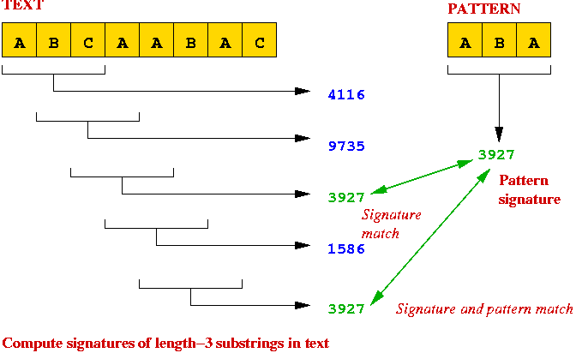
Substring Pattern Matching (Rabin–Karp Algorithm)
Compute the "signature" of the pattern.
Compute the "signature" of each substring of the text.
Scan text until signature matches
=> potential match, so perform string comparison

Slide 14
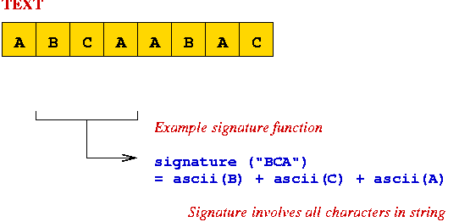
Substring Pattern Matching
signature involves all characters
=> computing signature for each substring takes O(m) time.
=> no faster than naive search.

Slide 15
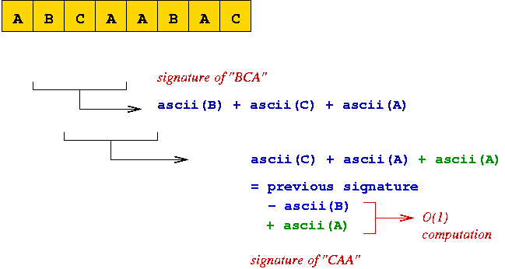
Substring Pattern Matching
Observation: two successive substrings differ by only two characters.
=> next signature can be computed quickly (O(1)).

Slide 16
External Hashing?
Recall search trees (binary trees/AVL trees) => B-trees
  Each tree node holds multiple key ranges
What if the hash table is too large to be in main memory?
How about just using disk addresses instead of memory addresses?
  Hash table = hash file
  Slot position = offset in the hash file
  References in separate chaining = file addresses
Issues:
  Worst time access - O(N) random disk accesses
  Hash table reorganization - O(N) random disk accesses

Slide 17
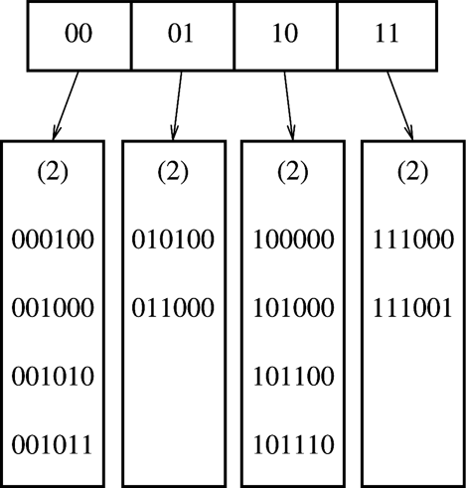
Extendible Hashing
Fagin, R.; Nievergelt, J. & Pippenger, N. et al. (September, 1979), "Extendible Hashing - A Fast Access Method for Dynamic Files", ACM Trans. on Database Systems 4(3)
Choose a hash function with a large range.
Use i senior bits as an offset into a table of bucket addresses.
Store entries in the buckets (≈ disk block)
  Entries in the same bucket share common prefix in hash values
Search for key K
  Compute h(K)
  Take i senior bits
  Look up the directory entry using i-bit offset
  Follow the bucket pointer
Notes:
The directory is just an array indexed by the i senior bits of the hash

Slide 18
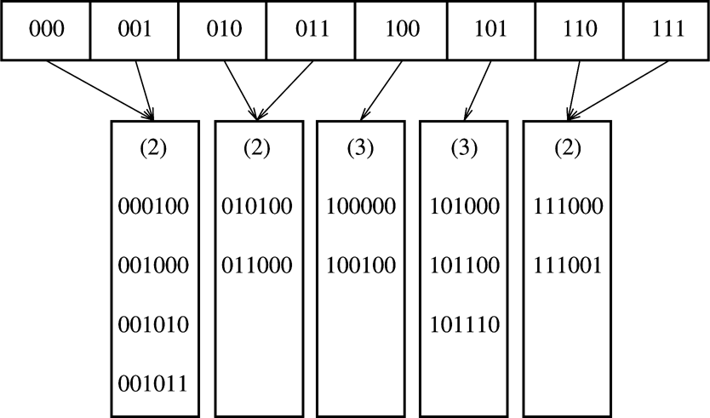
Insertions into Extendible Hash (Case 1)
Insertion of 100100: leaf split and directory split
  Only involves reorg of directory (main memory) and one bucket (localized damage)
Bucket’s common prefix can be shorter than i

Slide 19
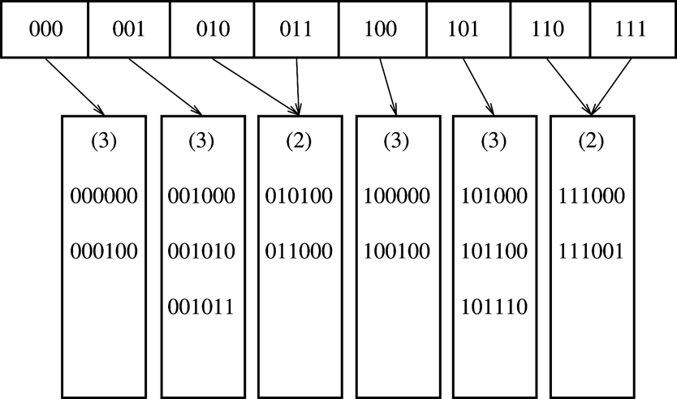
Insertions into Extendible Hash (Case 2)
Adding 000000 - leaf split only

Slide 20
Insertions into Extendible Hash (Case 3)
0000
0001
0010
0011
…
1110
1111
(2)
(2)
(4)
(4)
000100
001000
001010
001011
111000
111001
111010
111011
010100
011000
…
111100
Insert 111010, 111011, 111100
Last bucket to split
Can’t distinguish two new buckets with i+1 bits
  Increase directory offset bits by 2

Slide 21
Deletions from Extendible Hash
Reverse to insertions
Buckets may merge
Directory may be reorganized

Slide 22
Extendible Hash Discussion
B-trees
  B-tree nodes are less space efficient (store key ranges)
  Processing at a node (including root) requires matching a key against key ranges (logarithmic at best)
Extendible hash
  Constant-time directory access
  Directory is space-efficient (just bucket pointers)
  But: directory must fit into memory (otherwise reorganization is nightmare)
Researcher’s questions:
  What if directory does not fit into memory?
  Is this likely to happen?
    If yes, we have a problem to solve!
    If not, when do you ever want to use a B-tree?
      (Assuming you only need operations supported by a hash table)

